Slide 1
Developing Apps for Touch and Mobile Devices

Slide 2
Objectives
In this session, you will learn to:
  Identify devices
  Capture data from media devices
  Use a printer

Slide 3

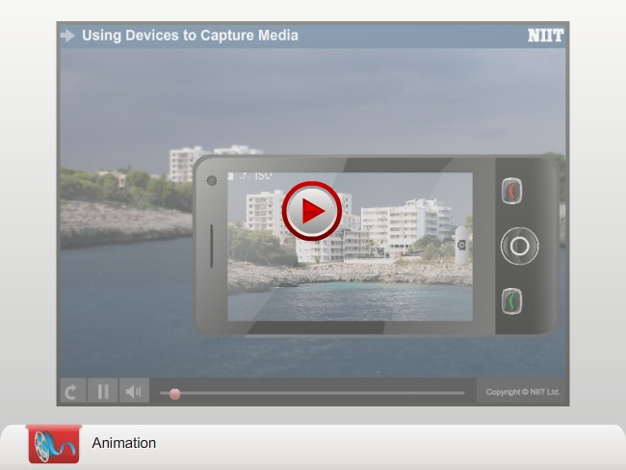
Enabling and Disabling Device Capabilities

Slide 4
Enabling and Disabling Device Capabilities (Contd.)
You need to declare a system feature in the app manifest to enable an app to use it.
The declaration states that the app has access to the specified features of the device.
The declaration can be done in the Capabilities tab of the package.appxmanifest file.

Slide 5
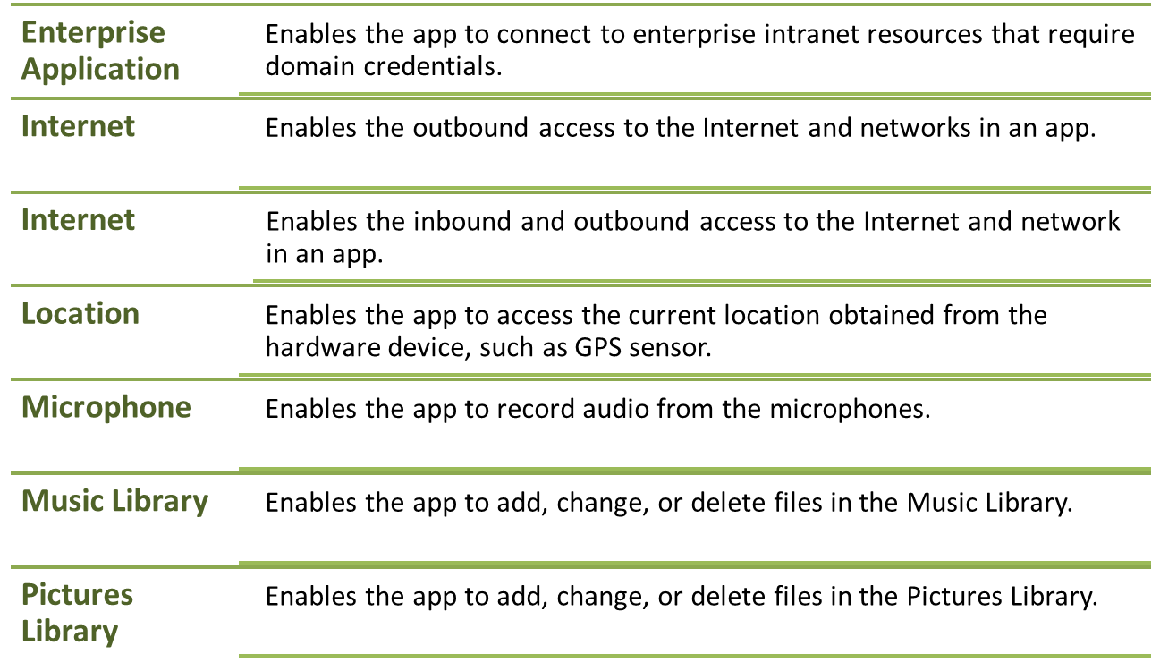
Enabling and Disabling Device Capabilities (Contd.)
Capabilities of a Windows 8.1/Windows Phone 8.1 app

Slide 6
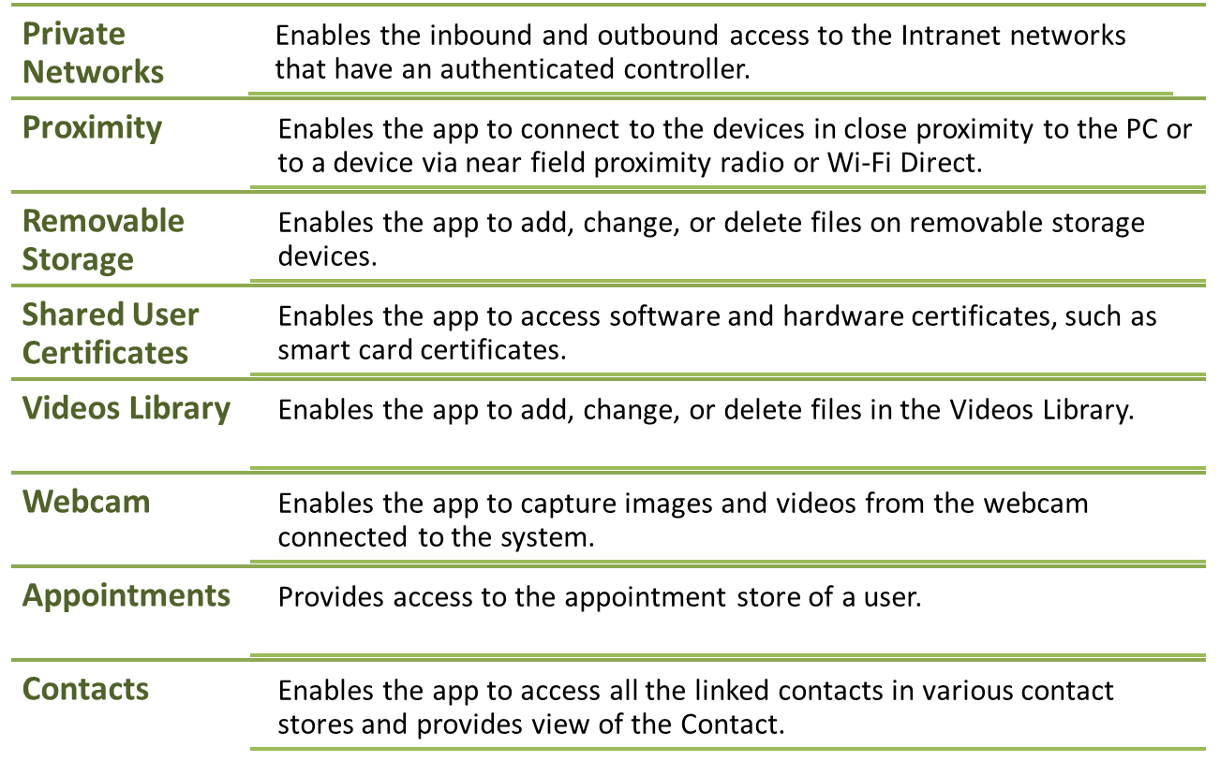
Enabling and Disabling Device Capabilities (Contd.)

Slide 7
Task 9.1: Enabling and Disabling Device Capabilities

Slide 8

Enumerating Devices
To display the various devices connected to the system, you need to enumerate them.
To enumerate devices you need to use the findAllAsync() method of the Windows.Devices.Enumeration namespace.
The findAllAsync() method enumerates all the DeviceInformation objects, where DeviceInformation is a class that represents a device.
Windows.Devices.Enumeration.DeviceInformation.findAllAsync().done(onSuccess, onError);
Enumerates all DeviceInformation objects

Slide 9

Enumerating Devices (Contd.)
The findAllAsync() method can be overloaded to enumerate the devices of the specified DeviceClass.
To enumerate all audio capture devices, use the following code snippet:
The following table shows the description of the DeviceClass enumeration members.
Windows.Devices.Enumeration.DeviceInformation.findAllAsync(Windows.Devices.Enumeration.DeviceClass.audioCapture).done(/* Code for success and error methods */);
Member | Description
all | Enumerates all the devices
audioCapture | Enumerates all the audio capture devices
audioRender | Enumerates all the audio rendering devices
portableStorageDevice | Enumerates all the portable storage devices
videoCapture | Enumerates all the video capture devices
imageScanner | Enumerates all the scanning devices
location | Enumerates all the location aware devices

Slide 10


Enumerating Devices (Contd.)
Displaying Thumbnails
To display device-specific icons to the user, you can use the default thumbnail icon for each device.
The default thumbnail icon of the device can be displayed by using the getThumbnailAsync()method.
For example, the following figure depicts the default thumbnail icon
of a mouse.
device.getThumbnailAsync().done( /* Code for success and error methods */ );

Slide 11


Enumerating Devices (Contd.)
Displaying Glyph Thumbnails
The glyph thumbnail icon of a device can be displayed by using the getGlyphThumbnailAsync()method.
The getGlyphThumbnailAsync()method returns a glyph thumbnail icon of the device of size 256 × 256 pixels.
For example, the following figure depicts the default thumbnail icon of a mouse:
device.getGlyphThumbnailAsync().done( /* Code for success and error methods */ );
Displays the Glyph Thumbnail Image of a Device

Slide 12

Just a Minute
Which one of the following capabilities enables the app to connect through Wi-Fi Direct?
Proximity
Removable Storage
Shared User Certificates
Webcam
Answer:
Proximity

Slide 13
Activity 9.1: Enumerating Devices
Problem Statement:
Paul is developing a Windows 8.1 app that is capable of recording audio. In the app, he wants the user to select the audio device that will be used to record audio. Therefore, he decides to list the various audio devices connected to the system in a list view. Help Paul to meet this requirement.
Solution:
To complete this activity, you need to perform the following steps:
  Define UI elements.
  Make the app functional.
  Execute the app and verify the output.

Slide 14

Capturing Still Images
To capture a still image using a Windows Store 8.1 app, you need to create an object of the CameraCaptureUI class.
The CameraCaptureUI class provides a full window UI for capturing images with the help of a camera connected to the system.
The CameraCaptureUI class also provides camera controls.
To capture still images, you need to perform the following steps:
  Create an object of the CameraCaptureUI class.
var cameraCaptureUI = new Windows.Media.Capture.CameraCaptureUI();

Slide 15

Capturing Still Images (Contd.)
  Launch the CameraCaptureUI user interface using the CaptureFileAsync(mode) method.
cameraCaptureUI.CaptureFileAsync(Windows.Media.Capture.CameraCaptureUIMode.photo).done(onSuccess, onError);
Specifies that the UI to capture a still image must be shown
Specifies the success and error handlers
Specifies the code that will be executed when the user has failed to capture an image
Specifies the code that will be executed when the user has successfully captured an image

Slide 16

Capturing Still Images (Contd.)
  The following code snippet depicts the implementation of the onSuccess() method, in which the captured image is displayed to the user on the screen:
function onSuccess(file)
{
if(file)
document.getElementById("image").src
= URL.createObjectURL(file);
}

Slide 17
Activity 9.2: Capturing Still Images
Problem Statement:
Andrew is developing a Windows Store 8.1 app that can capture still images using the camera of the device. In this app, there is a Capture button. On the click of this button, the default camera UI is displayed. In this UI, the user can capture the image, which will be displayed on the screen. Help Andrew to develop the preceding app.
Solution:
To complete this activity, you need to perform the following steps:
  Design the UI of the app.
  Enable device capabilities.
  Make the app functional.
  Execute the app and verify the output.

Slide 18

Capturing Video
Capturing a video using a Windows Store 8.1 app is a similar process as that of capturing an image.
To capture still images, you need to specify the mode of the object of the CameraCaptureUI class as Windows.Media.Capture.CameraCaptureUIMode.video.
cameraCaptureUI.CaptureFileAsync(Windows.Media.Capture.CameraCaptureUIMode.video).done(onSuccess, onError);
Specifies the code that will be executed when the user has successfully captured a video
Specifies the code that will be executed when the user has failed to capture a video

Slide 19
Activity 9.3: Capturing Video
Problem Statement:
John is developing a Windows Store 8.1 app that can capture videos using the camera of the device. In this app, there is a Capture button. On the click of this button, the default camera UI is displayed. In this UI, the user can capture the video, which will be displayed on the screen. Help John to develop the preceding app.
Solution:
To complete this activity, you need to perform the following steps:
  Design the UI of the app.
  Enable device capabilities.
  Make the app functional.
  Execute the app and verify the output.

Slide 20
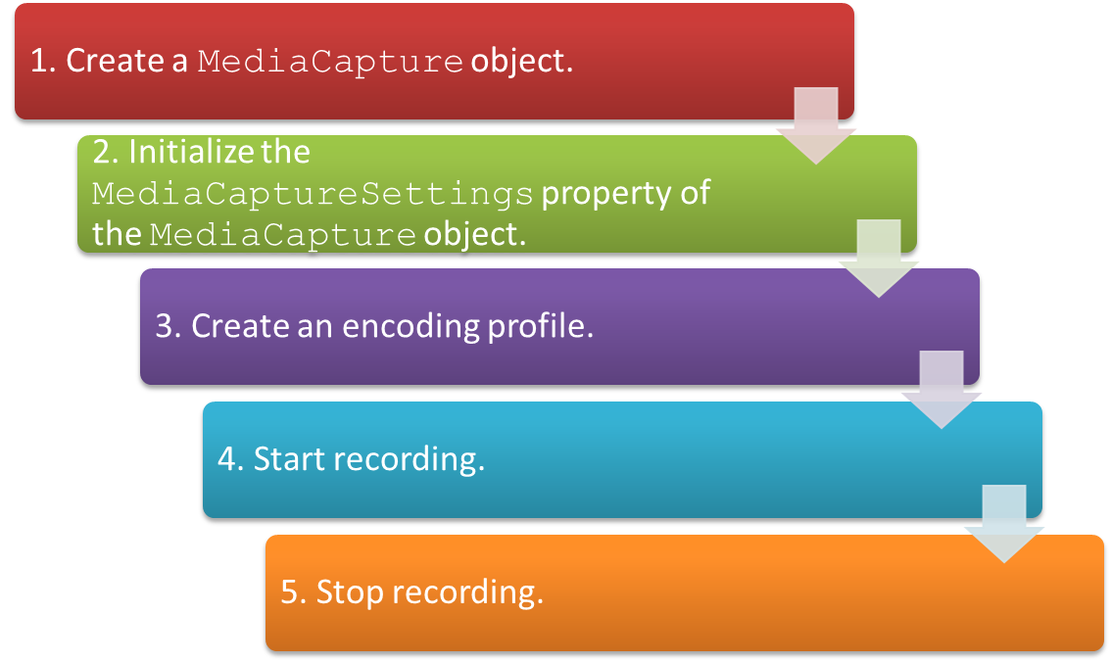
Capturing Audio
To capture audio using a Windows 8.1 app, you need to perform the following steps:

Slide 21
Activity 9.4: Capturing Audio
Problem Statement:
Martha is developing a Windows Store 8.1 app in which the user is able to record sound through the microphone on the click of a button. Help Martha to develop the app.
Solution:
To complete this activity, you need to perform the following steps:
  Design the UI of the app.
  Enable device capabilities.
  Make the app functional.
  Execute the app and verify the output.

Slide 22

Synthesizing Speech
Speech synthesis, also known as Text-To-Speech (TTS), can be implemented in a Windows Store 8.1 app by using the SpeechSynthesis API.
The SpeechSynthesis API enables you to:

Slide 23

Synthesizing Speech (Contd.)
The following code can be used to generate speech from plain text:
var audio = new Audio();
var synth = new Windows.Media.SpeechSynthesis.SpeechSynthesizer();
synth.synthesizeTextToStreamAsync("Hello World").done(onSuccess, onError);
The constructor creates an object of the Audio class to store the audio file
Converts a text string to a media stream
Text to be converted (input parameter)
Defines the success and error handlers

Slide 24

Synthesizing Speech (Contd.)
The success handler can be defined, as shown in the following code snippet:
function onSuccess(markersStream)
{
var blob = MSApp.createBlobFromRandomAccessStream(markersStream.ContentType, markersStream);
audio.src = URL.createObjectURL(blob, { oneTimeOnly: true });
audio.play();
}
The audio stream returned by the synthesizeTextToStreamAsync() method
Creates a URL for the blob object
Plays the audio
Specifies that the URL is created for one-time use and does not need to be revoked
To play the audio, the audio stream is converted into a blob object.

Slide 25


Synthesizing Speech (Contd.)
If you want the text to be narrated in the default system voice, then you can get the default voice of the system by using the defaultVoice property of the Windows.Media.SpeechSynthesis.SpeechSynthesizer class.
The following code snippet can be used to access the default voice of the system:
To access all the voices installed on the system, you need to use the following code:
var defaultVoice = Windows.Media.SpeechSynthesis.SpeechSynthesizer.defaultVoice;
var allVoices = Windows.Media.SpeechSynthesis.SpeechSynthesizer.allVoices;

Slide 26


Synthesizing Speech (Contd.)
To set a particular voice to be used for narrating a text, you need to set the voice property of the SpeechSynthesizer class with the type of voice:
To use the first voice available in the allVoices array for speech synthesis, you can use the following code:
synth.voice = defaultVoice;
synth.voice = allVoices[0];

Slide 27
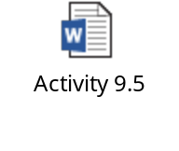
Activity 9.5: Synthesizing Speech
Problem Statement:
Solution:
To complete this activity, you need to perform the following steps:
  Design the UI of the app.
  Make the app functional.
  Execute the app and verify the output.

Slide 28

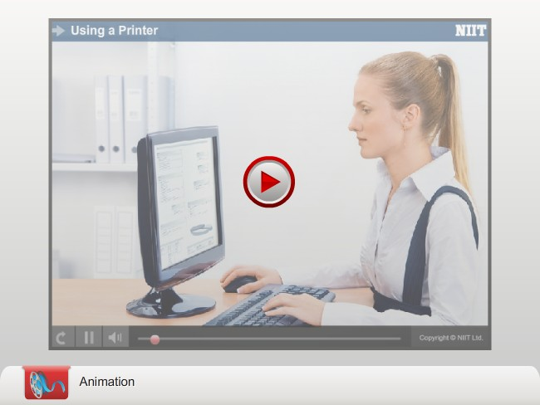
Printing from Your App

Slide 29
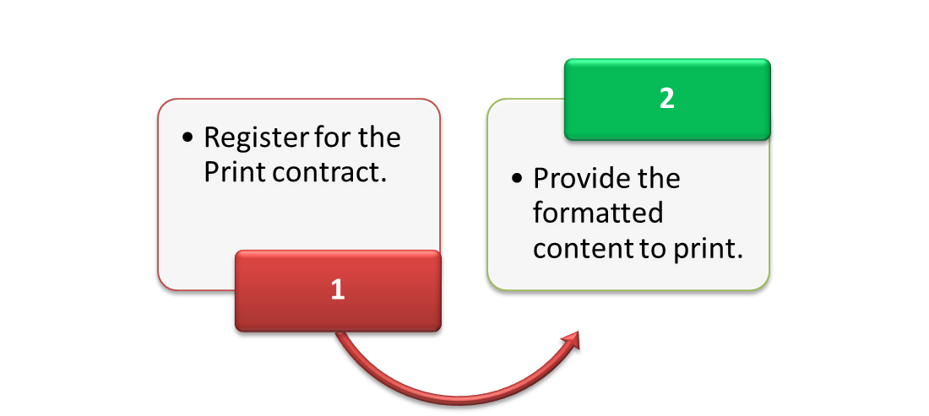
Printing from Your App (Contd.)
To print from your Windows Store app, you need to use Windows printing.
To use Windows printing in your app, perform the following tasks:

Slide 30
Printing from Your App (Contd.)
Register for the Print contract
To register for the Print contract, you need to create an object of the PrintManager class.
The PrintManager class indicates that the view of the app, in which its object has been created, is capable of printing.
The PrintManager class is used to initiate the printing process programmatically.

Slide 31



Printing from Your App (Contd.)
To create an object of the PrintManager class and enable printing for the current screen:
To register the handler for the onprinttaskrequested event:
var printManager = Windows.Graphics.Printing.PrintManager.getForCurrentView();
printManager.onprinttaskrequested = printTaskRequested;
To create a print task:
var printTask = printEvent.request.createPrintTask("Print Sample App", printContent);

Slide 32

Printing from Your App (Contd.)
Provide the formatted content to print
To print a specific text from the screen, you can use the following code snippet:
var fragment = document.createDocumentFragment();
var div = document.createElement("div");
var data = document.getElementById("txtData").value;
div.innerHTML = data;
fragment.appendChild(div);
args.setSource(MSApp.getHtmlPrintDocumentSource(fragment));

Slide 33
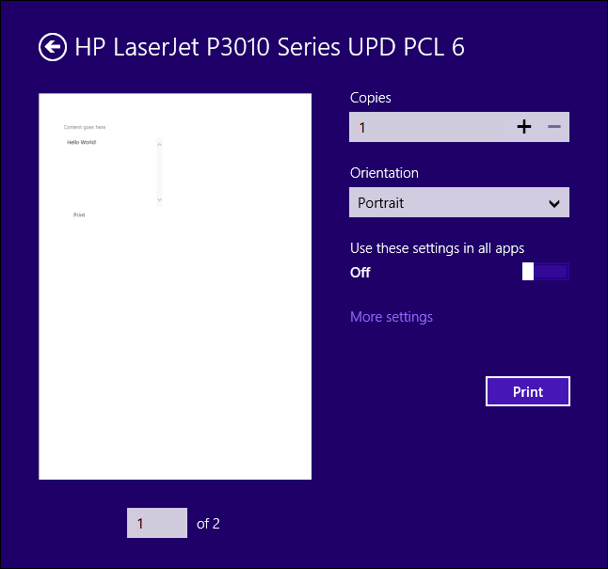
Changing Standard Options in the Print Preview UI
In a Windows Store app, when you initiate the Print command, a Print Preview UI is displayed.
The Print Preview UI displays the preview of the final print and the various print options, such as size and orientation.
Print Preview UI With Default Print Options

Slide 34
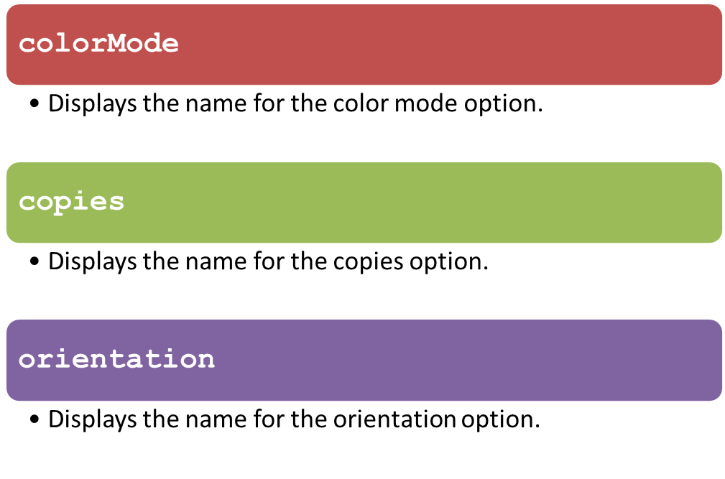
Changing Standard Options in the Print Preview UI (Contd.)
By default, the Print Preview UI shows the following print options:

Slide 35
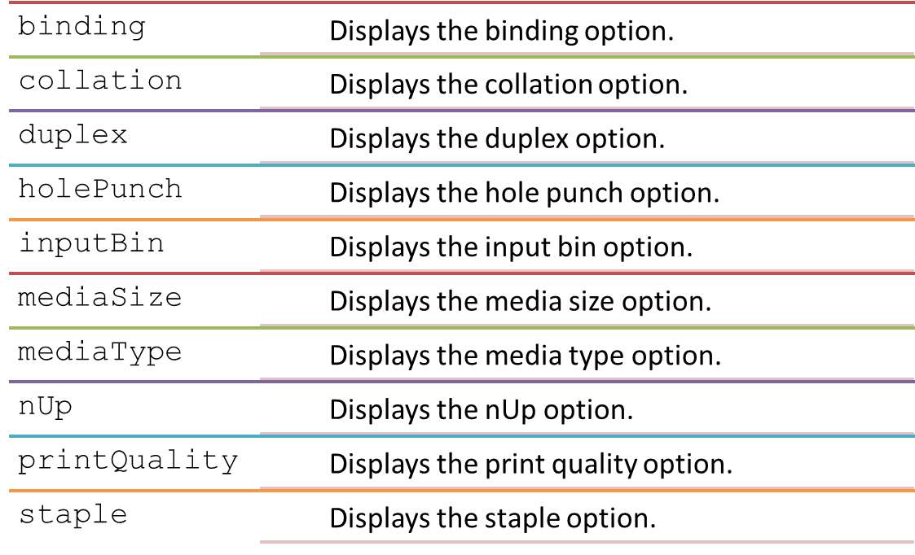
Changing Standard Options in the Print Preview UI (Contd.)
The print preview UI can also display the following common print options:

Slide 36

Changing Standard Options in the Print Preview UI (Contd.)
To clear the default print options, and then add the print options in a customized order:
printTask.options.displayedOptions.clear();
printTask.options.displayedOptions.append(Windows.Graphics.Printing.StandardPrintTaskOptions.copies);
printTask.options.displayedOptions.append(Windows.Graphics.Printing.StandardPrintTaskOptions.mediaSize);
printTask.options.displayedOptions.append(Windows.Graphics.Printing.StandardPrintTaskOptions.orientation);
printTask.options.displayedOptions.append(Windows.Graphics.Printing.StandardPrintTaskOptions.duplex);
Clears the default print options displayed in the print preview UI
Adds the various print options in the customized order

Slide 37

Activity 9.6: Using a Printer
Problem Statement:
Solution:
To complete this activity, you need to perform the following steps:
  Define the UI of the app.
  Register for the Print contract.
  Provide formatted content to print.
  Modify the Print Preview UI.
  Execute the app and verify the output.

Slide 38
Summary
In this session, I learned that:

